Slide 1
A Gift of Fire
Third edition
Sara Baase
Chapter 9: Professional Ethics and Responsibilities
Slides prepared by Cyndi Chie and Sarah Frye

Slide 2
What We Will Cover
What is Professional Ethics?
Ethical Guidelines for Computer Professionals
Scenarios

Slide 3
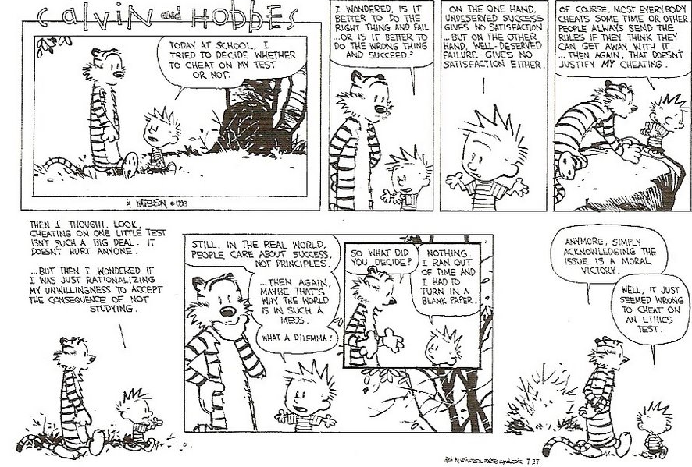

Slide 4
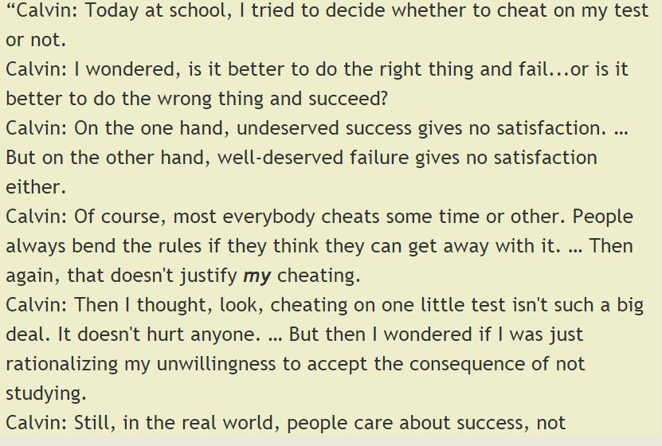

Slide 5
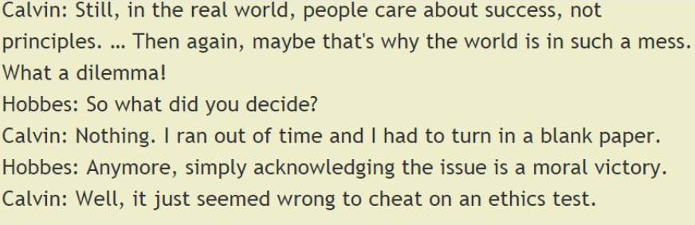

Slide 6
What is "Professional Ethics"?
Professional ethics includes relationships with and responsibilities toward customers, clients, coworkers, employees, employers, others who use one’s products and services, and others whom they affect
A professional has a responsibility to act ethically. Many professions have a code of ethics that professionals are expected to abide by
  Medical doctors
  Lawyers and judges
  Accountants

Slide 7
What is "Professional Ethics"? (cont.)
There are special aspects to making ethical decisions in a professional context
Honesty is one of the most fundamental ethical values; however, many ethical problems are more subtle than the choice of being honest or dishonest
Some ethical issues are controversial

Slide 8
Some Important Distinctions
Right, wrong, and okay
Negative and Positive Rights
Distinguishing Wrong and Harm
Separating goals from constraints
Personal preference and ethics
Law and Ethics

Slide 9
Ethical Guidelines for Computer Professionals
Guidelines and Professional Responsibilities:
Understand what success means
Include users (such as medical staff, technicians, pilots, office workers) in the design and testing stages to provide safe and useful systems
Do a thorough, careful job when planning and scheduling a project and when writing bids or contracts
Design for real users

Slide 10
Ethical Guidelines for Computer . . . (cont.)
Guidelines and Professional Responsibilities (cont.):
Don’t assume existing software is safe or correct; review and test it
Be open and honest about capabilities, safety, and limitations of software
Require a convincing case for safety
Pay attention to defaults
Develop communication skills

Slide 11
Scenarios
Methodology:
Brainstorming phase:
  List all the people and organizations affected (the stakeholders)
  List risks, issues, problems, and consequences
  List benefits. Identify who gets each benefit
  In cases where there is no simple yes or no decision, but rather one has to choose some action, list possible actions

Slide 12
Scenarios (cont.)
Methodology:
Analysis phase
  Identify responsibilities of the decision maker
  Identify rights of stakeholders
  Consider the impact of the options on the stakeholders (consequences, risks, benefits, harms, costs)
  Categorize each potential action as ethically obligatory, prohibited, or acceptable
  When there are multiple options, select one, considering the ethical merits of each, courtesy to others, practicality, self-interest, personal preferences, etc.

Slide 13
Reinforcing Exclusion
Voice Recognition
Hand writing
Nontechnical users
Different ethnic groups
Disabled people
Older people
Children

Slide 14
Copying an employee’s file
You are a computer system manager. An employee is out sick and another employee requests that you copy all files from the sick person’s computer to his so he can do some work.

Slide 15
Scenarios
Scenario 1:
Your team is working on a computer controlled laser device for treating cancerous tumors. The computer controls direction, intensity, and timing of the beam that destroys the tumor. Various delays have put the project behind schedule, and the deadline is approaching. There will not be time to complete all the planned testing. The system has been functioning properly in the routine treatment scenario that have been tested so far. You are the project manager, and you are considering whether to deliver the system on time, while continuing testing, and to make patches if bugs are found.
Notes:
Have the class analyze the scenario using the brainstorming and analysis methodology.

Slide 16
Scenarios
Scenario 2:
Suppose you are a member of a team working on a computer-controlled crash avoidance system for automobiles. You think the system has a flaw that could endanger people. The project manager does not seem concerned and expects to announce completion of the project soon. Do you have an ethical obligation to do something?
Notes:
Have the class analyze the scenario using the brainstorming and analysis methodology.

Slide 17
Scenarios
Scenario 3:
Your company has 25 licenses for a computer program, but you discover that it has been copied onto 80 computers.
Notes:
Have the class analyze the scenario using the brainstorming and analysis methodology.

Slide 18
Scenarios
Scenario 5:
You work for the IRS, the Social Security Administration, a movie-rental company, or an Internet service provider. Someone asks you to get a copy of records about a particular person. He will pay you $500.
Notes:
Have the class analyze the scenario using the brainstorming and analysis methodology.

Slide 19
Scenarios
Scenario 6:
You have a small consulting business. The CyberStuff company plans to buy software to run a new collaborative content-sharing Web site. CyberStuff wants to hire you to evaluate bids from vendors. Your spouse works for NetWorkx and did most of the work in writing the bid that NetWorkx plans to submit. You read the bid while your spouse was working on it and you think it is excellent. Do you tell CyberStuff about your spouse’s connection with NetWorkx?
Notes:
Have the class analyze the scenario using the brainstorming and analysis methodology.

Slide 20
Scenarios
Scenario 7:
A team of programmers is developing a communications system for firefighters to use when fighting a fire. Firefighters will be able to communicate with each other, with supervisors near the scene, and with other emergency personnel. The programmers will test the system in a field near the company office.
Notes:
Have the class analyze the scenario using the brainstorming and analysis methodology.

Slide 21
Scenarios
Scenario 8:
You are the computer system administrator for a mid-sized company. You can monitor the company network from home, and you frequently work from home. Your niece, a college student, is visiting for a week. She asks to use your computer to check her e-mail. Sure, you say. You are being a gracious host. What is the ethical problem?
Notes:
Have the class analyze the scenario using the brainstorming and analysis methodology.

Slide 22
Scenarios
Scenario 9:
You are a relatively junior programmer working on modules that collect data from loan application forms and convert them to formats required by the parts of the program that evaluate the applications. You find that some demographic data are missing from some forms, particularly race and age. What should your program do? What should you do?
Notes:
Have the class analyze the scenario using the brainstorming and analysis methodology.

